Slide 1




GRADE 9-10 · AP PRECALCULUS · UNIT 1
Topic 1.9
Vertical
Asymptotes
Journey of 6 stations, 60 minutes
Polynomial and Rational Functions
Mr Malek Thiab
FAITH, RIGHTEOUSNESS AND WISDOM
Notes:
Speaker notes: Welcome to Topic 1.9: Vertical Asymptotes.
Timing: 60 minutes (Diagnose 6, Targeted Instruction 18, Practice 12, Production 12, Mastery Gate 6, Smart Production 6). For a 40-minute class scale every station by two thirds.
The journey map on the next slide shows the six stations; in slideshow mode the Morph transition zooms the station circles into the breadcrumb at the top of every later slide.

Slide 2


Today's journey
Six stations. Each one zooms in as we arrive.
Targeted Instruction
18 min
Production
12 min
Smart Production
6 min
2
4
6
1
3
5
Diagnose
6 min
Practice
12 min
Mastery Gate
6 min
FAITH, RIGHTEOUSNESS AND WISDOM
Notes:
Speaker notes: This is the whole map. Walk it left to right: Diagnose (what we already know), Targeted Instruction (Where are the vertical asymptotes?; Behavior near a vertical asymptote; Multiplicity and the two sides), Practice (Practice, Apply, Investigate), Production (a ferry on a river), Mastery Gate (three questions to pass), Smart Production (create, then Time to Check).
In slideshow mode the Morph transition animates these circles shrinking into the breadcrumb on later slides; without Morph the slides fade.
Ask the class which station they think will be hardest.

Slide 3
What we are learning
OBJECTIVES
VOCABULARY
Determine vertical asymptotes of graphs of rational functions.
rational function
vertical asymptote
real zero
multiplicity
one-sided limit
increases without bound
decreases without bound
domain
STANDARDS
LO 1.9.A Determine vertical asymptotes of graphs of rational functions.
LO 1.9.A
FAITH, RIGHTEOUSNESS AND WISDOM
Mr Malek Thiab · 3
Notes:
Speaker notes: Read the objectives aloud one at a time and have students say which one they feel least sure about.
Vocabulary used today: rational function, vertical asymptote, real zero, multiplicity, one-sided limit, increases without bound, decreases without bound, domain.
Standards are listed on this slide.
The essential question and mathematical practices are not shown because they are not in the project documents; add them from the curriculum map if you want them displayed.

Slide 4


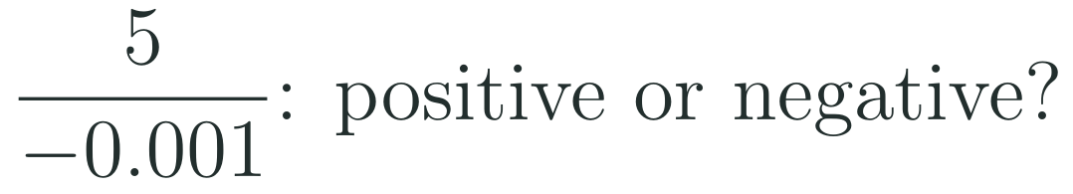
1
2
3
4
5
6
STATION 1 · DIAGNOSE · 6 MIN
Start here: three quick checks
1
2
3
Done when
All three answers are written without a calculator, and you can say how you checked each one.
LO 1.9.A
FAITH, RIGHTEOUSNESS AND WISDOM
Mr Malek Thiab · 4
Notes:
Speaker notes (Diagnose, 6 min, no calculator):
Speaker notes (Diagnose, 6 min, no calculator).
Solutions: Q1 x^2 - x - 6 = (x - 3)(x + 2), because -3 and 2 multiply to -6 and add to -1. Q2 (x - 1)(x + 4) = 0 gives x = 1 or x = -4. Q3 5 divided by -0.001 is -5000, which is negative: a positive number over a tiny negative number is a large negative number.
Verbal misconceptions: 'the zeros of (x + 4) is x = 4' (sign error); 'a tiny denominator makes the answer tiny' (dividing by a small number gives a large number); 'the sign of a quotient comes from the numerator only'.
Adaptive routing: if more than 30% miss Q1 or Q2, route to slide 5 (zeros of the denominator). If more than 30% miss Q3, route to slide 6 (sign near an asymptote).

Slide 5

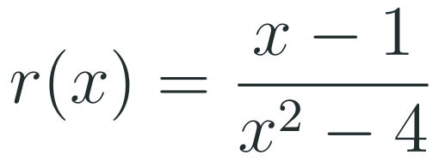
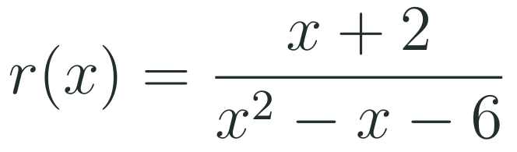
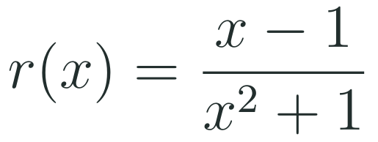
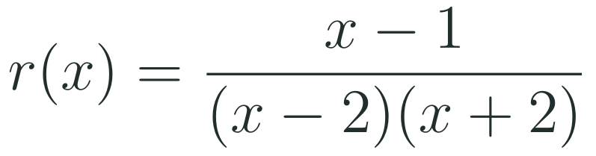
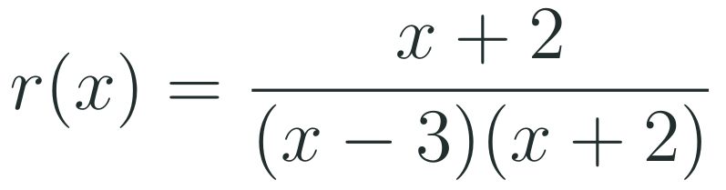


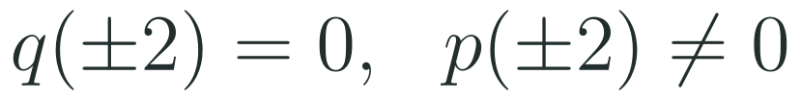

1
2
3
4
5
6
STATION 2 · TARGETED INSTRUCTION · 18 MIN
Where are the vertical asymptotes?
EXAMPLE A
EXAMPLE B
EXAMPLE C
LO 1.9.A
FAITH, RIGHTEOUSNESS AND WISDOM
Mr Malek Thiab · 5
Notes:
Speaker notes (Targeted Instruction, block 1 of 3):
Speaker notes (Targeted Instruction, block 1 of 3, LO 1.9.A). Source: AP Precalculus Course and Exam Description (College Board). EK 1.9.A.1 begins: 'If the value a is a real zero of the polynomial in the denominator of a rational function' and continues with the condition that a is not also a zero of the numerator, or that its multiplicity in the denominator is greater than in the numerator. The full verbatim sentence could not be fetched (the CED PDF was not reachable); the rules on the slide restate it (check against the CED PDF).
Worked solutions: Example A: x^2 - 4 = (x - 2)(x + 2). The denominator is 0 at x = 2 and x = -2. The numerator x - 1 is 1 at x = 2 and -3 at x = -2, never 0, so both are vertical asymptotes. Example B: x^2 - x - 6 = (x - 3)(x + 2). At x = 3 the numerator is 5 (not 0): vertical asymptote x = 3. At x = -2 the numerator is also 0 and the factor x + 2 cancels: a hole (Topic 1.10), not an asymptote. Example C: x^2 + 1 = 0 has no real solution, so there is no vertical asymptote and the domain is all real numbers.
Verbal misconceptions: 'every zero of the denominator is an asymptote' (check the numerator first); 'the asymptote of (x - 3) is x = -3' (sign error); 'the zeros of the numerator give asymptotes' (they give x-intercepts).
Adaptive routing: if more than 30% miss Gate Q1, return to this slide and redo Example B aloud.

Slide 6


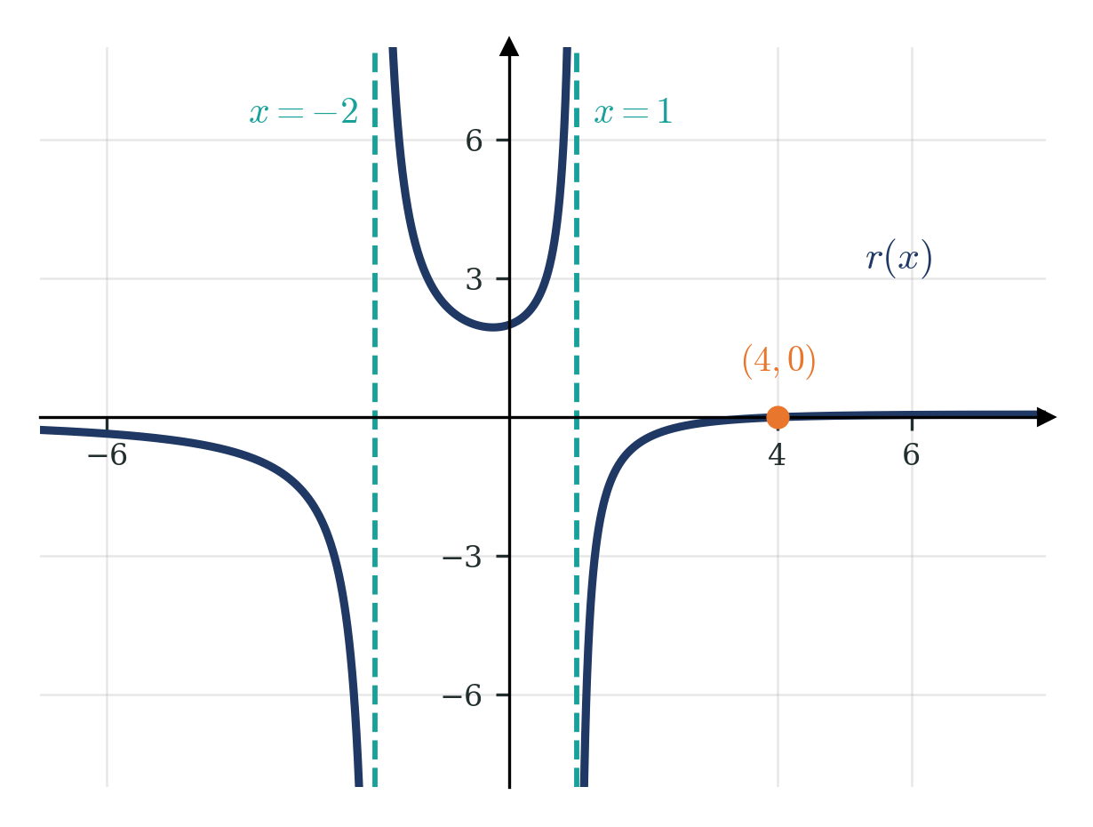
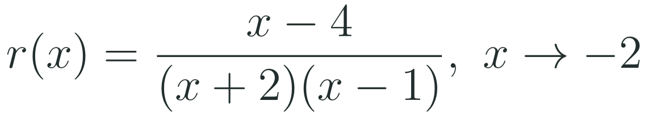
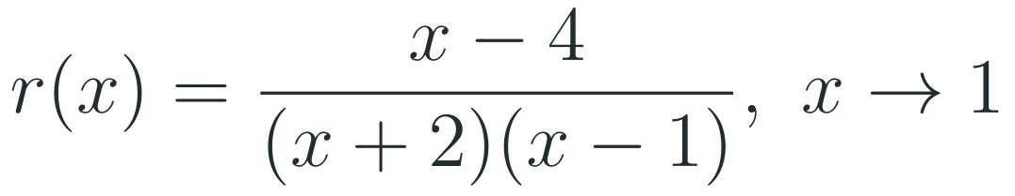
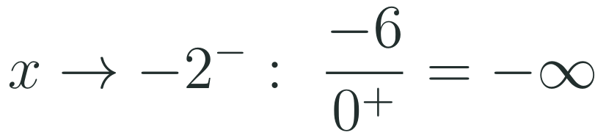
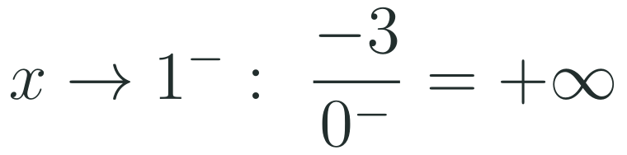
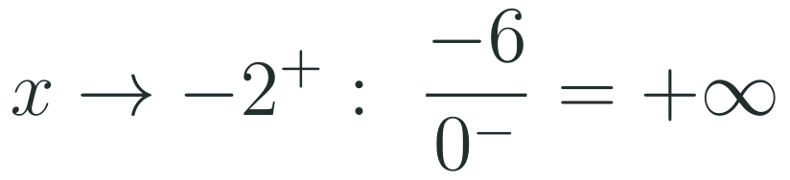
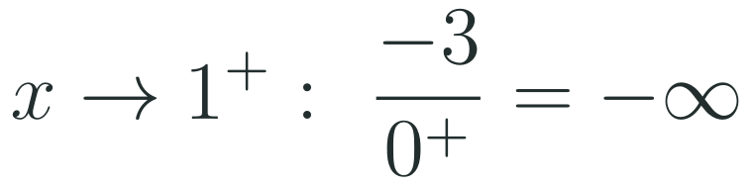

1
2
3
4
5
6
STATION 2 · TARGETED INSTRUCTION · 18 MIN
Behavior near a vertical asymptote
EXAMPLE A
EXAMPLE B
LO 1.9.A
FAITH, RIGHTEOUSNESS AND WISDOM
Mr Malek Thiab · 6
Notes:
Speaker notes (Targeted Instruction, block 2 of 3):
Speaker notes (Targeted Instruction, block 2 of 3, LO 1.9.A). EK 1.9.A.2 begins: 'Near a vertical asymptote, x = a, of a rational function,' and continues that the values of the function increase or decrease without bound, described with one-sided limit notation. The full verbatim sentence could not be fetched (check against the CED PDF).
Worked solutions: r(x) = (x - 4)/((x + 2)(x - 1)). Example A, near x = -2: the factors other than x + 2 are x - 4 = -6 and x - 1 = -3, so the numerator is -6 and the other denominator factor is -3. From the left, x + 2 is a tiny negative number, so the denominator (x + 2)(x - 1) is a tiny positive number (negative times negative): -6 over tiny positive = -infinity. From the right, x + 2 is tiny positive, the denominator is tiny negative: -6 over tiny negative = +infinity. Example B, near x = 1: the numerator is -3 and x + 2 is 3. From the left, x - 1 is tiny negative, the denominator is tiny negative: -3 over tiny negative = +infinity. From the right the denominator is tiny positive: -3 over tiny positive = -infinity. These agree with the graph: the branch left of x = -2 falls, the middle branch rises on both ends, the branch right of x = 1 comes up from below and crosses the x-axis at (4, 0).
Verbal misconceptions: 'the graph goes up on both sides of every asymptote' (check the sign on each side); 'infinity is a number the function reaches' (the values increase or decrease without bound); 'the limit exists because the graph gets close to the line' (the one-sided limits are not finite).
Adaptive routing: if more than 30% miss Gate Q2, return to this slide and redo Example A with a sign table for each factor.

Slide 7



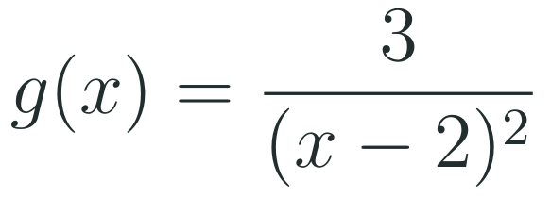
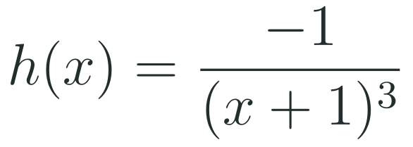
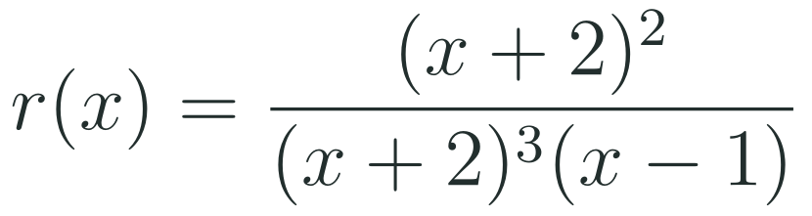
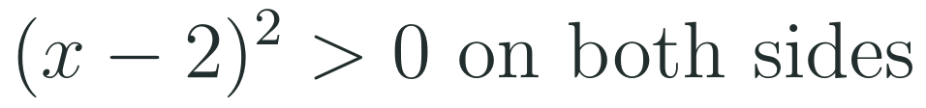
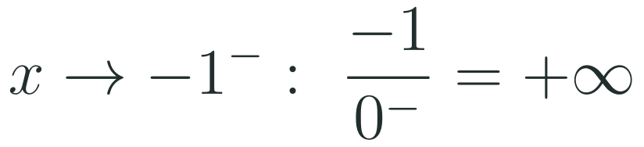
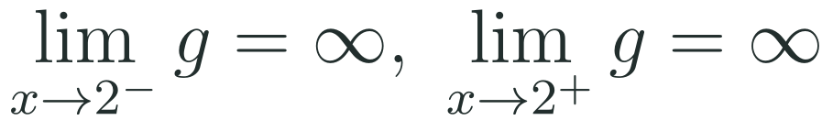
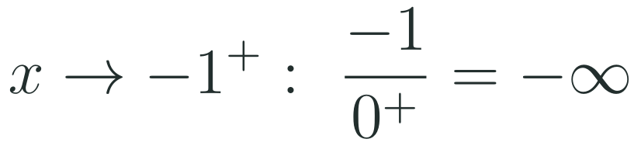
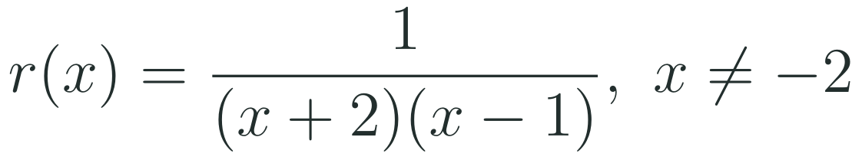


1
2
3
4
5
6
STATION 2 · TARGETED INSTRUCTION · 18 MIN
Multiplicity and the two sides
EXAMPLE A
EXAMPLE B
EXAMPLE C
LO 1.9.A
FAITH, RIGHTEOUSNESS AND WISDOM
Mr Malek Thiab · 7
Notes:
Speaker notes (Targeted Instruction, block 3 of 3):
Speaker notes (Targeted Instruction, block 3 of 3, LO 1.9.A). EK 1.9.A.1 includes the multiplicity condition: a vertical asymptote also occurs at x = a when the multiplicity of a as a zero of the denominator is greater than its multiplicity as a zero of the numerator (paraphrased from the part of the CED text that could be fetched; check against the CED PDF).
Worked solutions: Example A: (x - 2)^2 is positive on both sides of 2 and tends to 0, so 3/(tiny positive) = +infinity from both sides. Example B: (x + 1)^3 has the sign of x + 1. From the left it is tiny negative: -1 over tiny negative = +infinity. From the right it is tiny positive: -1 over tiny positive = -infinity. Example C: the zero x = -2 has multiplicity 3 in the denominator and 2 in the numerator; 3 > 2, so the factor (x + 2)^2 cancels but one factor x + 2 remains in the denominator: vertical asymptote x = -2 (no hole). The zero x = 1 appears only in the denominator: vertical asymptote x = 1. The simplified form 1/((x + 2)(x - 1)) holds for x not equal to -2.
Verbal misconceptions: 'if a factor cancels there is no asymptote' (only when the numerator multiplicity is at least the denominator multiplicity); 'a squared factor means there is no asymptote'; 'every asymptote goes up on one side and down on the other' (even multiplicity does not).
Adaptive routing: if more than 30% miss Gate Q3, return to this slide and redo Example C aloud, counting multiplicities in a two-column table.

Slide 8
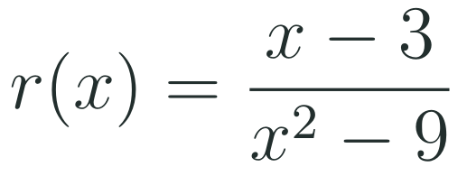
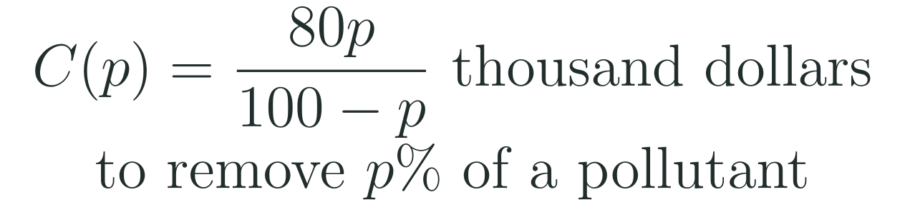
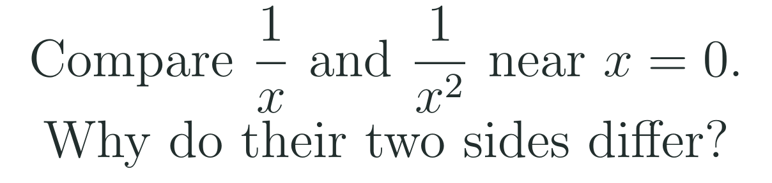
1
2
3
4
5
6
STATION 3 · PRACTICE · 12 MIN
Give it a go: Practice, Apply, Investigate
PRACTICE
APPLY
INVESTIGATE
Secure the method
Use it in context
Find out why
Done when: you factor first, list every zero of the denominator, and mark each as an asymptote or not.
Done when: the asymptote is written as an equation and you finish the sentence: as the percentage approaches 100 from the left, the cost...
Done when: your explanation uses the sign of the denominator on each side and names the multiplicity of the zero.
LO 1.9.A
FAITH, RIGHTEOUSNESS AND WISDOM
Mr Malek Thiab · 8
Notes:
Speaker notes (Practice, 12 min; tierless differentiation: students choose the starting column and may move across):
Speaker notes (Practice, 12 min; tierless: students choose the starting column and may move across).
Answers: Practice: x^2 - 9 = (x - 3)(x + 3), so r(x) = (x - 3)/((x - 3)(x + 3)). The factor x - 3 cancels (hole at x = 3, point (3, 1/6)); x + 3 remains: vertical asymptote x = -3 only. Apply: 100 - p = 0 at p = 100 and the numerator is 8000 there, so the vertical asymptote is p = 100. For p slightly less than 100 the denominator is tiny positive, so C(p) increases without bound: removing nearly all of a pollutant costs more and more (check: C(50) = 4000/50 = 80 thousand dollars; C(99) = 7920 thousand dollars). The domain 0 <= p < 100 stops before the asymptote. Investigate: 1/x changes sign at 0 (odd multiplicity: -infinity from the left, +infinity from the right); 1/x^2 has a squared denominator that is positive on both sides (even multiplicity: +infinity from both sides).
Verbal misconceptions: 'if the denominator is zero there is always an asymptote' (Practice); 'the cost at p = 100 is a very large number' (it is undefined; the values grow without bound).
Adaptive routing: finished students move to Apply then Investigate; stuck students return to slide 5.

Slide 9
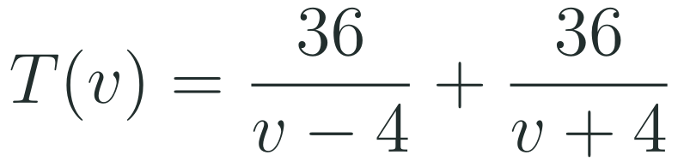

1
2
3
4
5
6
STATION 4 · PRODUCTION · 12 MIN
Production: a ferry on a river
THE MODEL
DONE WHEN
A ferry sails 36 km up a river against a current of 4 km per hour, then 36 km back with the current. Its speed in still water is v km per hour. The numbers are model values for practice, not a real timetable.
The single fraction is simplified and its denominator is factored.
Both asymptotes are written as equations.
The one-sided limit is written with the correct sign and explained in hours.
The time at 12 km per hour is given with units and the domain is used to reject the second asymptote.
Write the travel time as a single fraction and find its vertical asymptotes.
Use limit notation for v approaching 4 from the right and explain it in words for the ferry.
Find the round-trip time at 12 km per hour and say why the asymptote at negative 4 is not part of the model.
Hint: use the product of the two denominators as the common denominator, and multiply each numerator by the other factor.
LO 1.9.A
FAITH, RIGHTEOUSNESS AND WISDOM
Mr Malek Thiab · 9
Notes:
Speaker notes (Production, 12 min):
Speaker notes (Production, 12 min).
Solutions: Task 1: T(v) = [36(v + 4) + 36(v - 4)]/((v - 4)(v + 4)) = 72v/(v^2 - 16) = 72v/((v - 4)(v + 4)). The numerator is not 0 at v = 4 or v = -4, so the vertical asymptotes are v = 4 and v = -4. Task 2: the limit of T(v) as v approaches 4 from the right is +infinity (numerator 288 over a tiny positive denominator). Meaning: as the ferry's still-water speed gets closer to the 4 km per hour current, its speed against the current gets close to 0 and the upstream time increases without bound. Task 3: T(12) = 72(12)/(144 - 16) = 864/128 = 6.75 hours (check: 36/8 + 36/16 = 4.5 + 2.25 = 6.75). The model requires v > 4 (the ferry must beat the current), so v = -4 is outside the domain: a negative speed has no meaning here.
Verbal misconceptions: adding the fractions without a common denominator (36/(v - 4) + 36/(v + 4) is not 72/(2v)); writing v = 4 as the answer for both sides of a limit without a sign; thinking the asymptote at v = -4 also shapes the graph in the context.
Adaptive routing: if students cannot start, send them to slide 5 Example A and the hint.

Slide 10
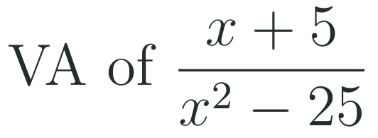
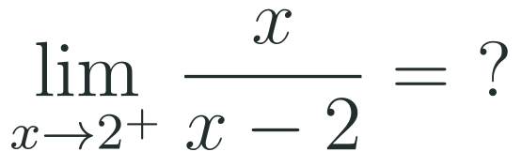
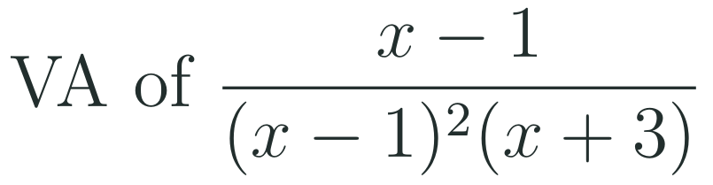
1
2
3
4
5
6
STATION 5 · MASTERY GATE · 6 MIN
Mastery Gate: three questions to pass
1
2
3
Pass mark
3 of 3 correct unlocks Station 6. Fewer than that: return to the slide for the question you missed, redo it, then re-take the gate.
LO 1.9.A
FAITH, RIGHTEOUSNESS AND WISDOM
Mr Malek Thiab · 10
Notes:
Speaker notes (Mastery Gate, 6 min, no calculator):
Speaker notes (Mastery Gate, 6 min, no calculator).
Answers: Q1 x^2 - 25 = (x - 5)(x + 5); the factor x + 5 cancels, so the only vertical asymptote is x = 5 (hole at x = -5). Q2 numerator 2, denominator tiny positive: +infinity. Q3 the zero x = 1 has multiplicity 2 in the denominator and 1 in the numerator, so after cancelling, one factor x - 1 remains: vertical asymptote x = 1; also x = -3. So x = 1 and x = -3.
Verbal misconceptions: Q1 'x = 5 and x = -5' (both zeros of the denominator) or 'x = -5 only'; Q2 'the limit is 0' or '-infinity' (sign of x - 2 on the right); Q3 'x = -3 only' (cancelled the whole factor x - 1).
Adaptive routing: Q1 missed, route to slide 5 Example B; Q2 missed, route to slide 6 Example A; Q3 missed, route to slide 7 Example C.

Slide 11
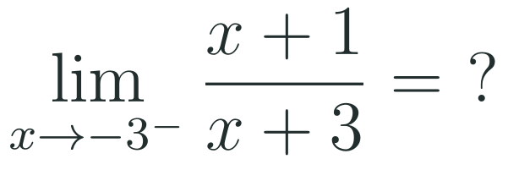
1
2
3
4
5
6
STATION 6 · SMART PRODUCTION · 6 MIN
Smart Production: make one, then check it
CREATE
TIME TO CHECK
Write a rational function with vertical asymptotes at negative 2 and at 5 and a zero at 1.
Check it: factor your denominator and confirm that no numerator zero cancels an asymptote.
Swap with a partner: they list the asymptotes and the sign of the output just to the right of 5.
Exit ticket: write your answer on a sticky note and place it on the door.
Done when: your partner confirms both asymptotes, the zero and the sign to the right of 5.
Next lesson: Topic 1.10 Rational Functions and Holes.
LO 1.9.A
FAITH, RIGHTEOUSNESS AND WISDOM
Mr Malek Thiab · 11
Notes:
Speaker notes (Smart Production, 6 min):
Speaker notes (Smart Production, 6 min).
Create example: r(x) = (x - 1)/((x + 2)(x - 5)): the denominator is 0 at -2 and 5, the numerator is 0 only at 1, so the asymptotes are x = -2 and x = 5. Just right of x = 5: numerator 4, (x + 2) = 7, (x - 5) tiny positive: positive, so r tends to +infinity. Exit answer: numerator -2; x + 3 is tiny negative from the left: -2 over tiny negative = +infinity.
Verbal misconceptions: students write the asymptote with the wrong sign (x = 2 for the factor x + 2); students give the sign of the numerator alone.
Adaptive routing: if more than 30% miss the exit ticket, begin the next lesson with slide 6 Example A.

Slide 12
Journey complete
Targeted Instruction
Production
Smart Production
✓
✓
✓
✓
✓
✓
Diagnose
Practice
Mastery Gate
Factor first, then each real zero of the denominator that is not cancelled gives a vertical asymptote, and the signs of the factors on each side decide whether the graph rises or falls.
FAITH, RIGHTEOUSNESS AND WISDOM
Notes:
Speaker notes: Every station is checked off. Recap in one sentence: Factor first, then each real zero of the denominator that is not cancelled gives a vertical asymptote, and the signs of the factors on each side decide whether the graph rises or falls. Collect the Time to Check responses. Next lesson: Topic 1.10 Rational Functions and Holes.

